Slide 1
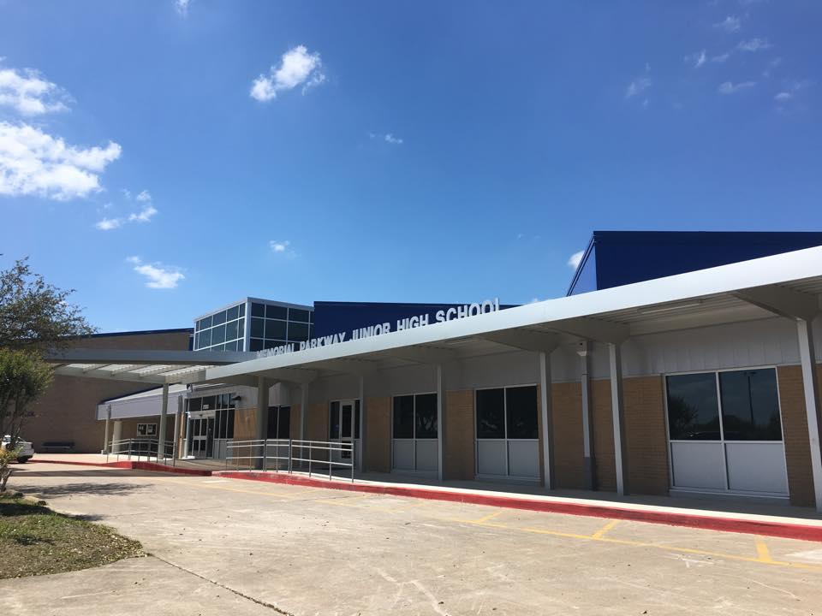
MPJH Course Selection
Incoming 6th grade
EAGLES ARE:
Trustworthy Accepting Leading Optimistic Noble Scholarly

Slide 2
MPJH Course Selection
Parent Night - Future 6th Grade Eagles
EAGLES ARE:
Trustworthy Accepting Leading Optimistic Noble Scholarly

Slide 3
MPJH Course Selection
Parent Night - Future 6th grade
Now you will hear from our:
Choir
Band
Theater
Orchestra
EAGLES ARE:
Trustworthy Accepting Leading Optimistic Noble Scholarly

Slide 4
MPJH Counselors
2024-25
Mrs. Garcia
Counselor
6th
Mrs. Tompkins
Counselor
7th
Mrs. Hardy
8th

Slide 5
All about MPJH
Colors: Blue & White
Motto: Trustworthy Accepting Leading Optimistic Noble Scholarly
Mascot: Eagles
School Hours 8:55-4:05
Before school tutoring is available every day
No recess
NO MORE STRAIGHT LINES
Pep Rallies
More responsibilities and privileges :)
New friends and interests

Slide 6
Junior High Differences
7 classes-45 minutes in length with different teachers
An advisory period to work on homework, study, intervention or see a teacher for extra help
Backpacks can be carried to each class. (no rolling backpacks)
30 minute lunch
Tardies! Students must get to class on time every period. 5 minute passing period between each class.
4 core classes (English & Reading block, Math, Science, Social Studies)
1 elective
P.E. - you are expected to dress out and participate every day.
Student ID’s used daily!
You will need a hard copy or digital planner to track your assignments.
Dismissal - no tags
Fun Food Fridays and Dances!

Slide 7
Three Class Formats
Academic – For everyone, on grade level, more time to review concepts, more tutoring provided, prepares students for college as well as other post secondary education
KAP (Katy Advanced Program)– More challenging, fast paced, requires independent learning, prepares students for AP classes in high school *Recommend current B average or higher in specific subject grade
GT – Must be currently screened and identified

Slide 8
KAP Math
Big difference in # of objectives covered 5th grade – approx. 60 objectives 6th grade Academic – approx. 64 objectives 6th grade KAP – over 90 objectives with some being 7th grade objectives
* 6th grade KAP: covers all of 6th and ½ of 7th grade math
*5th grade students who pass the 6th grade CBE will be placed in 7th grade KAP math & take 8th grade STAAR test
KAP level of instruction will focus on preparation for taking Algebra I (HS credit) in the 8th grade.

Slide 9
Electives All Junior High Students Must Take a Fine Arts Class
Whatever you choose, you will be in for the entire year.
You will attend daily and be graded.
DO
Consider carefully and choose the one that is of most interest to you!
DON’T
Let your friends influence your choice!
Electives:
Band * Orchestra * Choir * Theatre * Art *
Band /Orchestra directors will contact you before school is out about an instrument selection) *Supply Fees required
You will be able to tour the 6th grade elective options during the parent night.

Slide 10
Reading Elective and Math Lab
Students in the 5th grade who are unsuccessful on STAAR in Math and/or Reading this Spring may be placed in a Math Lab or Reading Improvement class. These classes may replace an elective and/or PE in 6th grade.
Small class sizes 15:1 ratio to provide support in Math or Reading

Slide 11
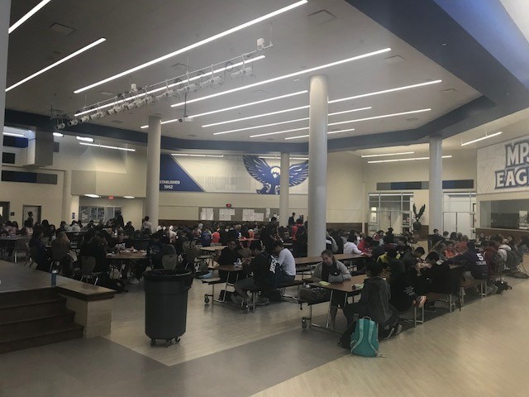
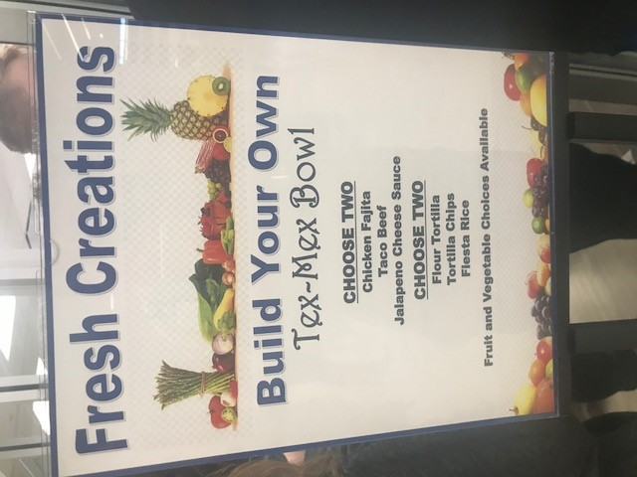
MPJH Cafe Experience...
Open seating
Multiple food options
Raise your hand to get up
Cleaning up your space :)

Slide 12
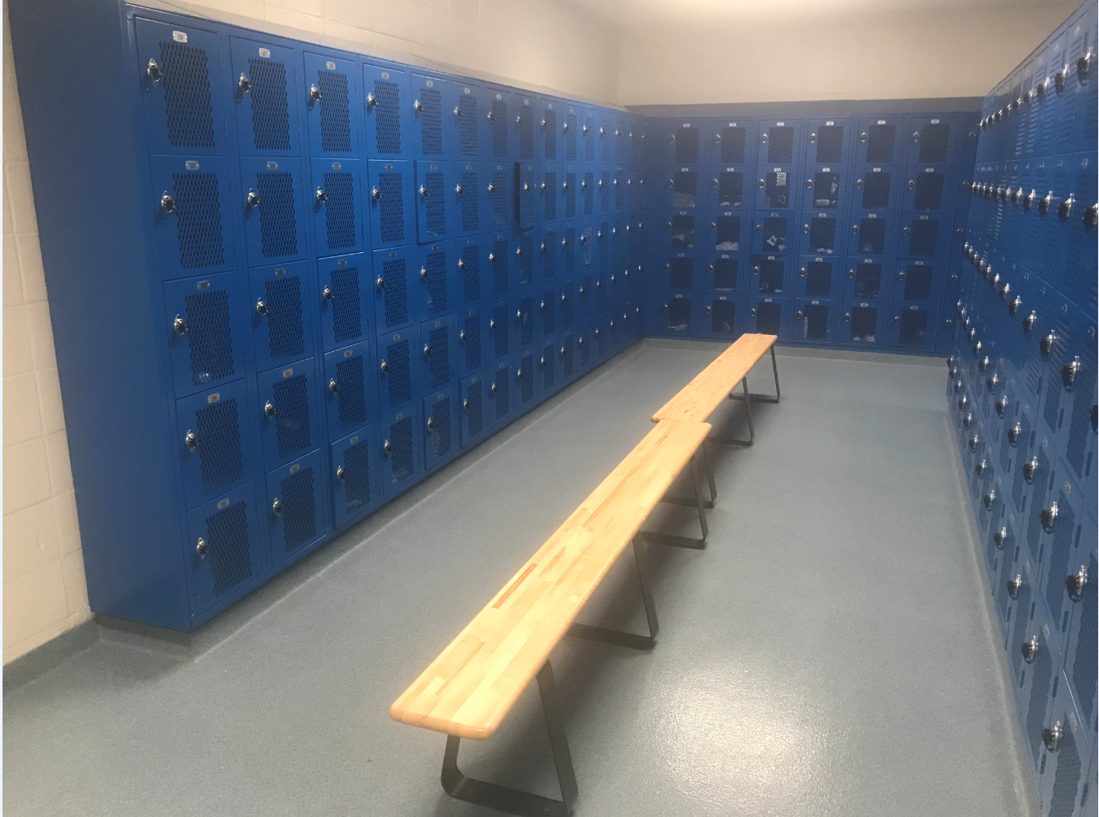
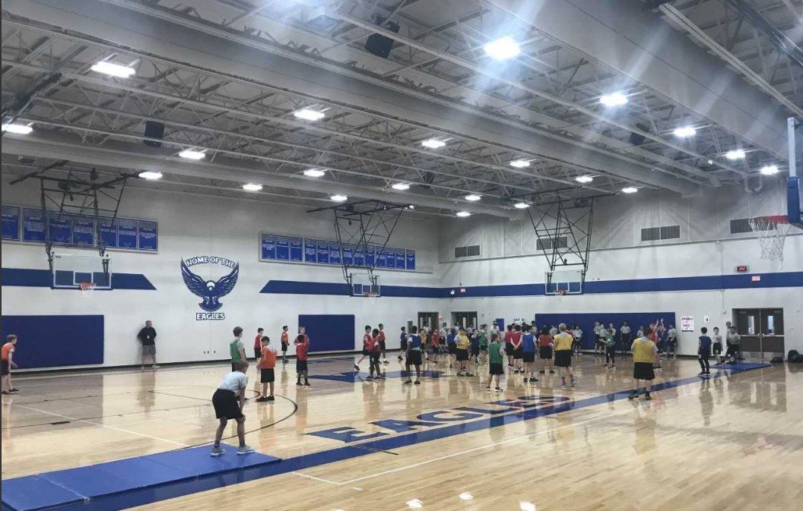
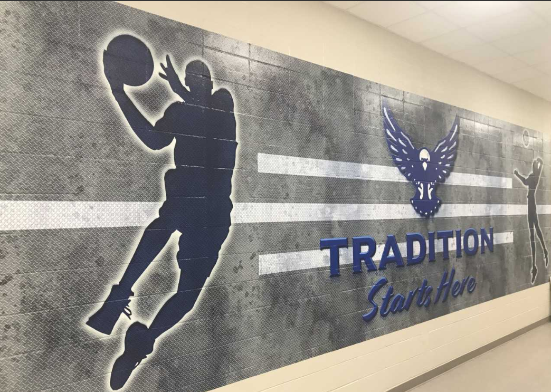
Physical Education &
Pre Athletics
Both boys and girls (separate gyms)
Graded class/attend every day
Dress out in uniforms (laundering fee)
Lockers in gyms
PE Waivers? *No Athletics (competitive sports) in 6th Grade
Notes:
Susie first slide

Slide 13
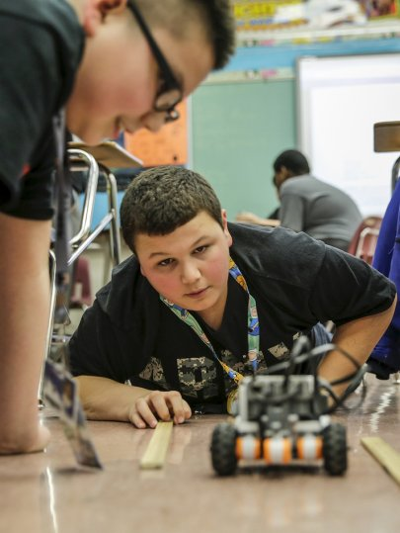
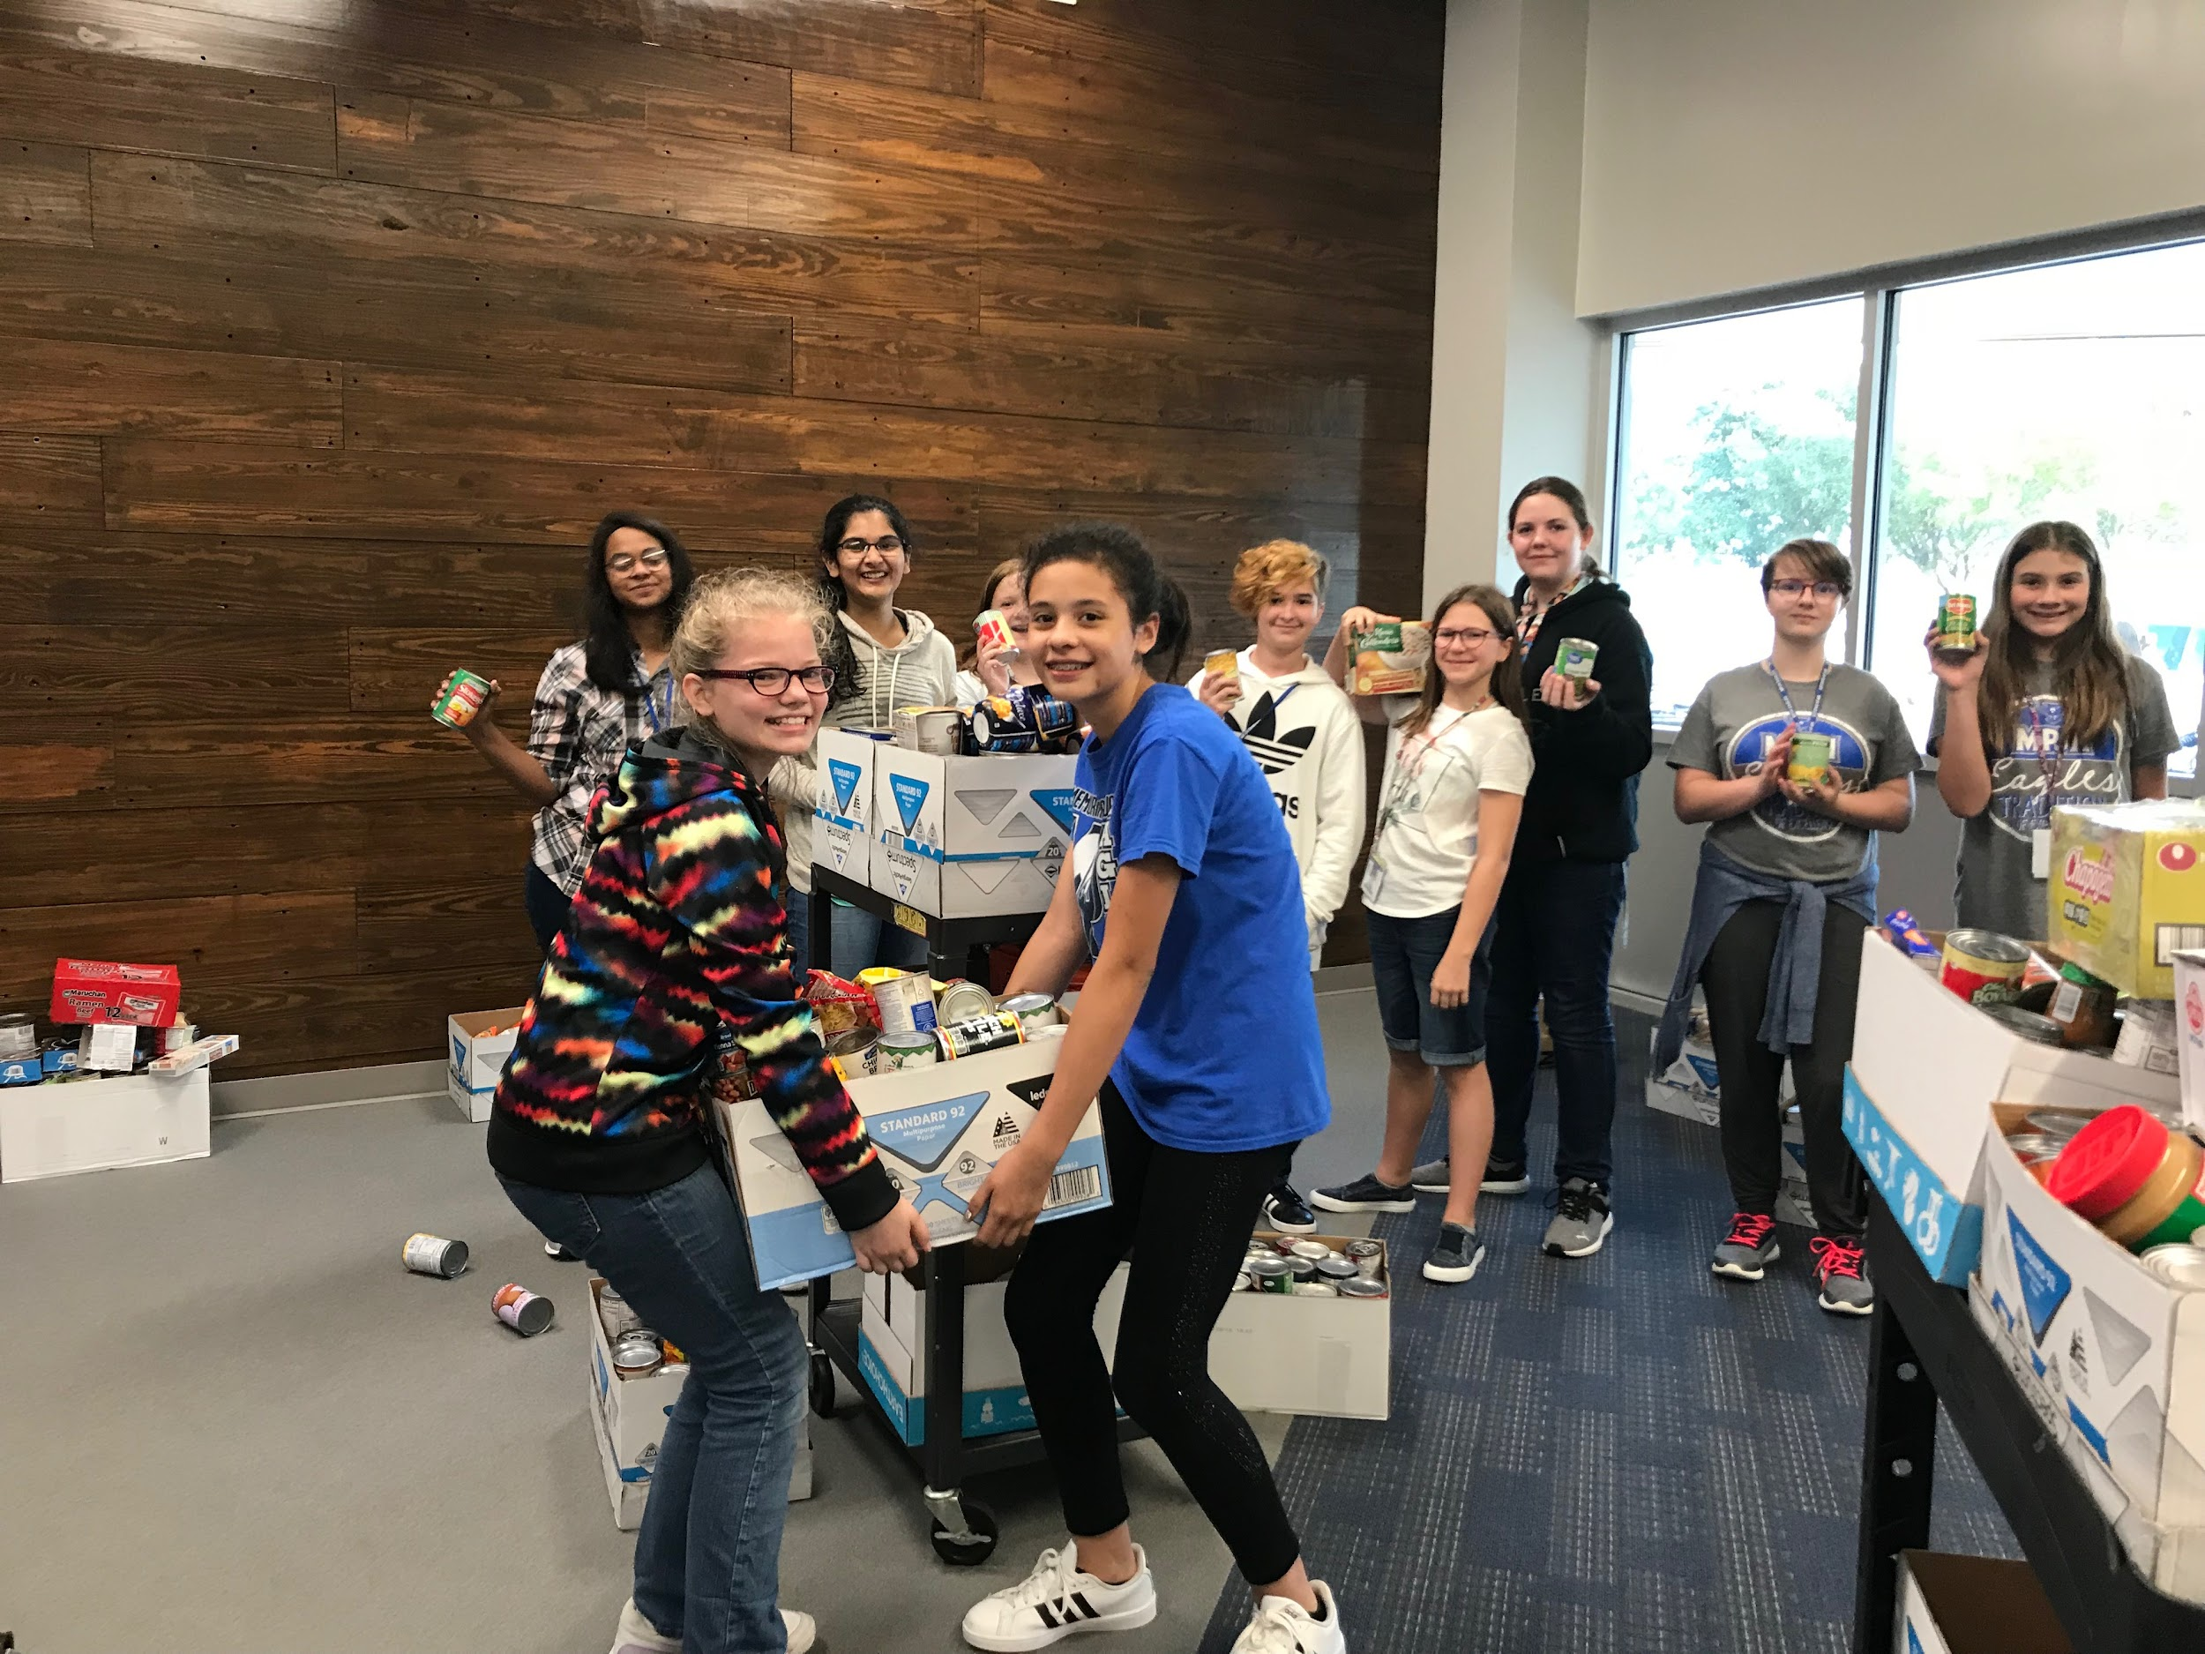
Clubs and Organization
Pep Squad
Students must participate in 6th grade if they want to try out for cheer in 7th or 8th grade
Robotics Club
Student Council
Also several
student led clubs

Slide 14
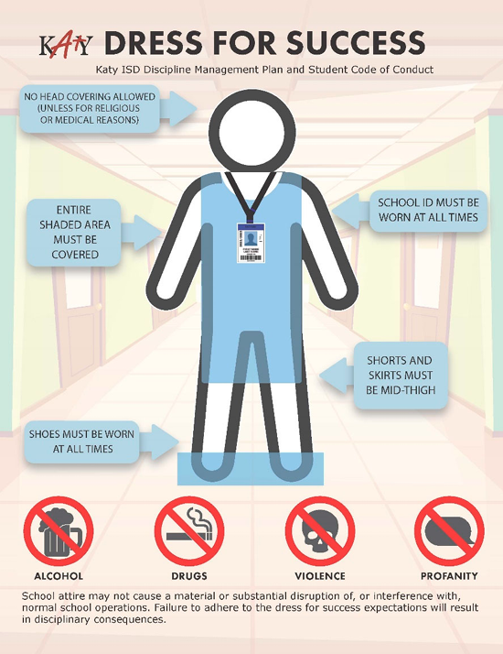
Let’s Talk About...
Dress Code for Girls & Boys
Short Length & Appropriate Size
Ripped Jeans
Shirts
Cell Phones
Off and inside backpacks throughout day
Classroom use only with permission
No pictures of others
IDs
Wear IDs daily
Place in zipped backpack at the end of 8th period

Slide 15
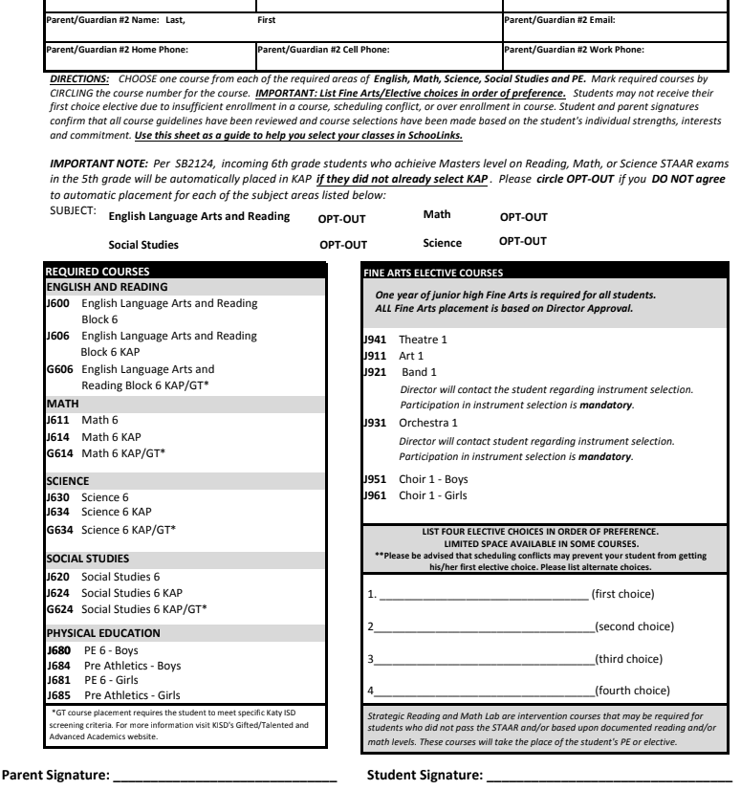
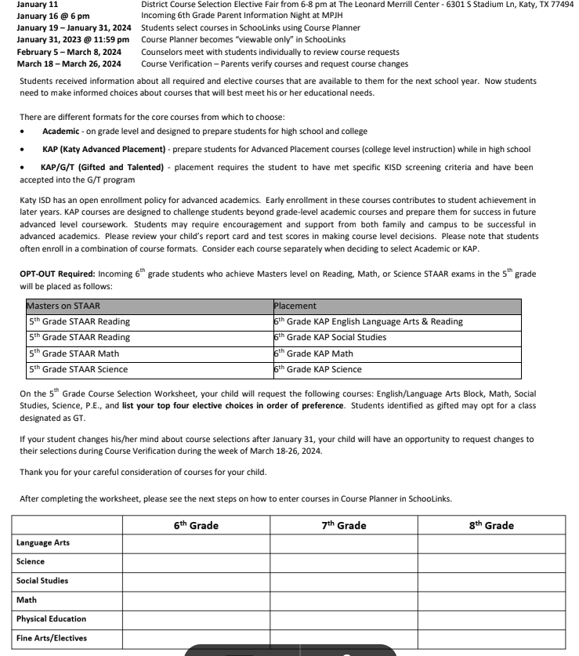
Course selection materials
*See your Counselor if you have any questions.
*Course Catalog will be available on SchooLinks

Slide 16
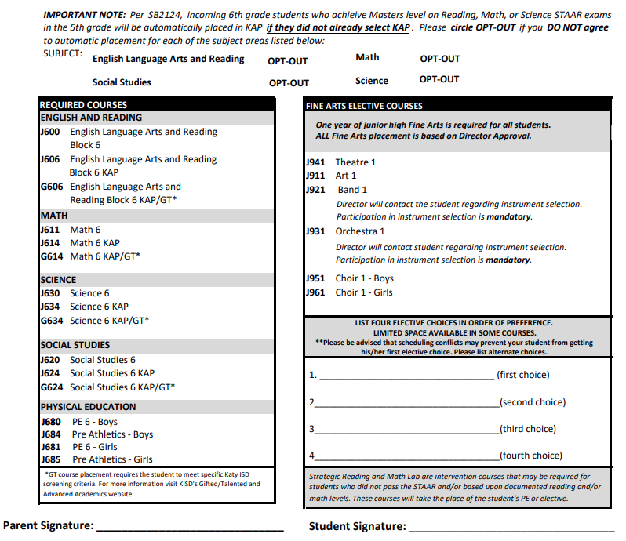
Completing Course Selection Sheet
Legal first and last name
Select the correct Level for core classes (Aca., KAP, KAP/GT) (Reading and English blocked)
List elective choice in the order from 1st choice - 4th choice. The elective you want the most should go 1st. Scheduling conflicts may prevent you from getting your first choice.
Parent & student signature needed
Parent & student must also read the back of the course selection sheet if selecting any KAP classes
Return course selection worksheet to your homeroom teacher by campus deadline February 1st.
J921 Band
J911 Art
J951 Choir
J941 Theatre
Evan Brown 1/12/24
Eva Brown 1/12/24

Slide 17
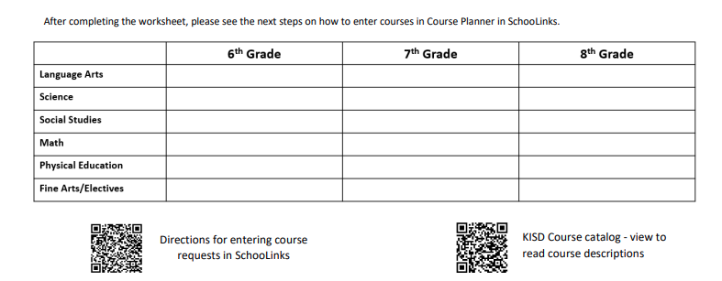
Complete before SchooLinks
Use “What classes can my student choose this year” sheet in your packet.

Slide 18
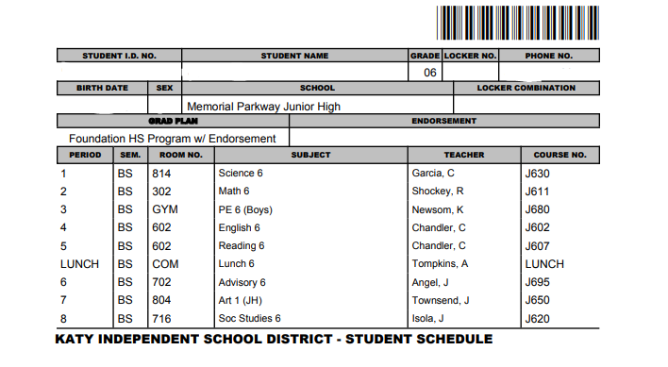
Sample 6th Grade Schedule

Slide 19
Annual Student Update
Parent please look for an Email in August 2024 regarding your Annual Student Update and complete it before school starts.

Slide 20
After today...
Complete Course Selection Sheet then turn your sheet into your 5th grade teacher.
Course Verification Sheet will be verified in Schoolinks THIS IS NOT A SCHEDULE! The Course Verification serves as a list of classes that you have requested. Electives are based on AVAILABILITY.
Follow instructions on Course Verification process in Schoolinks on how to make changes.
We will not change electives after Course Verifications are due in Schoolinks.

Slide 21
Future Events
Course selections are due by February 8th
6th grade Curriculum Night will be January 23rd
Band/Orchestra instrument fitting- Notification letters will be sent home to students who choose band or orchestra as 1st choice.
Incoming 6th grade tour - January 31
Eaglet Camp is the first week of August - TBD
Schedule 2024-25 - will be in HAC before school starts - August 14th
Tardies not taken the first week of school

